Slide 1
Analysis and Verification of Open-Source AI Systems CA 1
Supervisor: Yulei Sui
Feng Xu
Propose presenting time: Dec 16th, 2022, 3:00 p.m.
Notes:
Good afternoon, my name is Feng Xu.
I am a master by research student under prof. Sui’s supervision.
My research topic is analysis and verification of open-source AI systems.

Slide 2
Agenda
Literature Review
Work 1 to 3
Future
Notes:
Today’s presentation is composed of three parts.
The first one is the literature review.
The second one is future research works.
The third part is the work I have been involved in the past six months.
Now let’s move to the literature review part.

Slide 3
Literature Review
General structure
Property
Model encoding
Verification
Why verify
Future
Notes:
The literature review part consists of 6 subsections.
At first, I will talk about the reasons for verifying neural networks.
After that, I will illustrate the verification general structure in the literature.
Thirdly, it is necessary to state property formalization,
Fourthly, I will show model encoding methods
Fifthly, I will give model verification methods.
The last one is the possible future directions.

Slide 4
0. Two excluded paradigms
Estimation via statistical methods is often too large.
Bound via adversarial attack has no guarantee.
Notes:
Before moving on, I will first illustrate the methods not covered in the literature review.
Firstly, I will omit the statistical methods which evaluate local robustness with a probably approximately correct guarantee. This kind of verification allows a small error rate on the robustness property which becomes a probabilistic robustness property, it is like the label change rate in the DNN mutation testing. It returns the results of DNN satisfying a probabilistic robustness property with a given confidence.
There is also another branch of methods that bound the neural networks via adversarial attack. They use some methods, such as gradient descent or evolutionary techniques, to generate adversarial inputs.
They can efficiently find the adversarial inputs via these approaches, but they cannot ensure the actually bound, which we call “sound”, because we cannot enumerate all the adversarial attacks to feed into the methods.

Slide 5
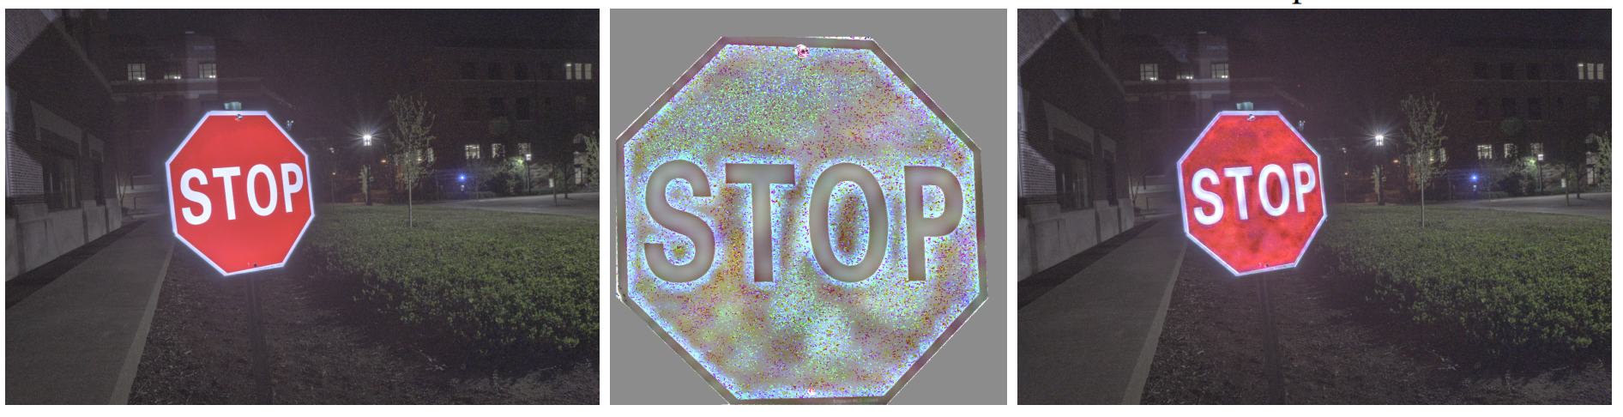
1. Why verify NNs
Using uniform illumination
Using Project-compensated illumination
Predict as “stop sign”
Predict as “Speed 30”
https://arxiv.org/pdf/2108.06247.pdf
Notes:
Let's start with the inspiration example.
Here is an example of an adversarial attack on pattern recognition in a security critical area. Traffic sign recognition is a crucial part of self-driving systems.
In a published paper, the authors use a projector to illuminate the stop sign. The stop sign was recognized as having a speed limit of 30.
In reality, if self-driving cars cannot stop at the sign, there will be plenty of traffic accidents.
The trustworthiness of neural works has turned out to be a new and challenging topic, especially for those deployed in safety and security critical systems.

Slide 6
1. Why verify NNs (cont.)
Neural Networks have been deployed in many systems.
Incorrect output with variances
No guarantee with logical constraints
Notes:
Deep neural networks have been incorporated into a wide range of applications.
They are increasingly applied to boost the efficiency of real-world systems and services with a growing volume of data.
Recent studies and research show that DNNs are imperfect, and most SOTA neural networks often produce incorrect output with variances
as they explored the performance of identical models with random seeds and nondeterminism-introducing factors under different training runs.
Neural networks are not guaranteed with theoretical or logical constraints for their behaviors compared with human-programmed software.
Neural networks are driven by data and lack sufficient approaches to analyze thoroughly.
The model may fail to correctly predict due to the lack of sufficient data, inadequate learning, and non-deterministic relations between inputs and outputs.
This is why we need to verify neural networks.

Slide 7
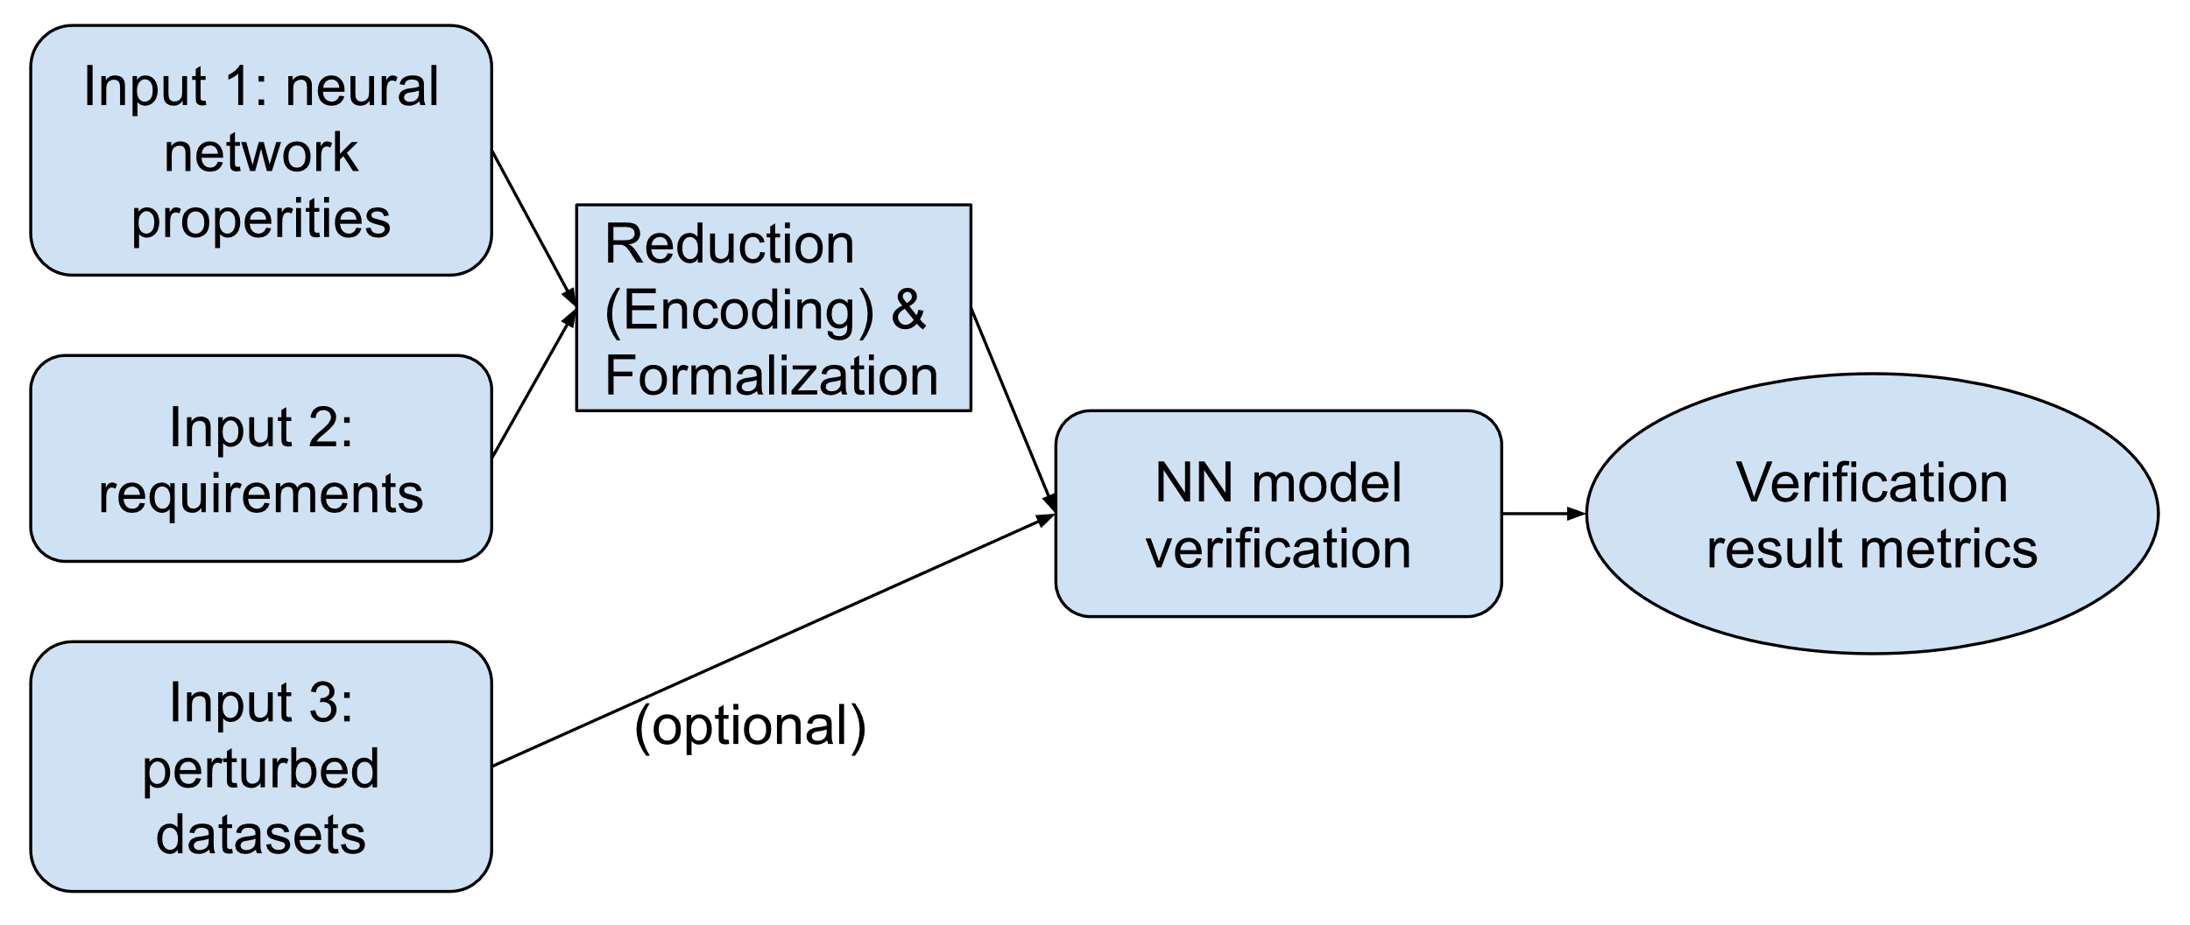
2. General Structure
Notes:
This is general structure of the methods in the literature review.
Generally, the neural networks verification starts with identifying the neural networks properties such as the input, with additional requirements from different tasks.
They will firstly formalize these properties and then encode (reduce) all properties for the specific verification methods. In the end, these methods will return a verification metrics.
When we try to verify neural networks, we can treat the neural networks in either black-box settings or white box settings. In the following three subsections, I will focus on the white box methods.

Slide 8
3. Property
What are neural network properties?
Input
Output
The mapping of input and output
Special structure in the neural networks
Notes:
Before verifying the neural network, we need to know what we can get from the neural networks.
The properties of a neural network could be captured from the semantic context of its speciﬁcation.
In general, the properties include input, output, mapping of these two, and the special structure in the neural networks, such as activation functions.
These properties will be formalized as a logic formula involving both input and output for different encoding strategies in the next slides.

Slide 9
4. Model Encoding
Boolean Satisfiability Problem / Linear Programming / Mixed Integer Linear Programming / Quadratic Programming
Layerwise Propagation / Discretization / Abstract Interpretation
Notes:
Generally, there are two categories of model encoding.
The first category includes Boolean Satisfiability Problems, Linear Programming, Mixed Integer Programming, and Quadratic Programming.
The second category includes Layerwise Propagation, Discretization, and Abstract Interpretation.
As I have mentioned in the general structure part, the neural network will be analyzed in white box settings.
The neural network properties consist of the white box settings.
In the Boolean satisfiability problem, it performs the analysis by transforming the entire neural network into a set of constraints in the form of propositional logic and linking certain constraints containing the input and output in one Boolean formula.
If we set the negation of constraints over the output nodes as the objective function and keep the remaining constraints unchanged, thus the veriﬁcation process is transformed into solving an optimization problem.
If the linear programming partially contains integer constraints, it will be mixed integer linear programming.
If the properties are encoded in an optimization problem in which both the objective function and the constraints are quadratic functions, it is the Quadratically Constrained Quadratic Program.
The layerwise propagation can solve the veriﬁcation as a reachability problem.
But layerwise propagation cannot deal with complex models. This encoding approach will raise scalability concerns in the verification process.
Discretization can mitigate the computational burden of verification. It converts a continuous function into several discrete pieces to achieve a finite exploration within an infinite search space.
One example discretization approach is that it discretizes the perturbation from the inﬁnite input distribution.
It propagates those discrete input vectors layer by layer and determines whether the robustness is preserved or not by observing the bounds of output.
Abstract interpretation is a veriﬁcation approach that provides a formalism of approximation and abstraction in a mathematical setting.
An abstract interpretation consists of an abstract domain, a pair of abstraction and concretization functions, and a sound abstract semantic function in the form of an iterative ﬁxed-point equation.
Abstract interpretation aims to simplify the veriﬁcation problem at the encoding stage.
Although the veriﬁcation is still treated as a reachability problem, it is solved by reasoning an abstract system rather than the original neural network model.
The mainstream abstraction interpretation approaches symbolize each node of the neural network, apply abstraction function over its computation, and ultimately determine whether the property is preserved through the output values after the concretization.

Slide 10
5. Verification
Constraint Reasoning – SMT
Mathematical Optimization – LP / MILP / SDP
Interval Arithmetic – SAT / LP
Linear Approximation – Abstract Interpretation
Iterative Refinement – MILP
Notes:
The next subsection is verification. In some literatures, the verification stage is also called reasoning.
Constraint reasoning is an analysis approach implemented by an off-the-shelf solver, and therefore it is also known as solver reasoning.
This reasoning option is designed to take a set of constraints as input but does not restrict any reduction setting applied in advance.
Reasoning through a satisﬁability modulo theories (SMT) solver is the most intuitive way to perform veriﬁcation of a neural network in SAT encoding
With the LP, MILP and SDP encoding selected, the veriﬁcation of a neural network could also be achieved through various mathematical optimizations. One typical technique in this type is duality, which theoretically enables us to certify the robustness property by proving if the dual problem is solvable, although its original form is not practically easy to be solved.
this reasoning approach is more effective in ﬁnding the maximum robustness of a neural network model and helping in further neural network optimization.
Interval arithmetic, also known as interval analysis or bound propagation, is essentially developed as a classical method to measure the bounds of errors in mathematical computation. It can also be used as an ideal method to evaluate the bounds of neural network output.
linear approximation aims to provide an estimated range of non-linear activation output.
Linear approximation is one of the primary reasoning techniques for abstract interpretation modeling. By applying linear approximation with layerwise symbolic analysis, it is expected to achieve a veriﬁcation with provable soundness and scalability.
Iterative reﬁnement has been proposed as a complementary technique to reinforce incomplete analysis such as over-approximation.
Some research adopts it to achieve a complete veriﬁcation despite diverse incomplete reasoning strategies being used, while most of the others take advantage of it to mitigate the incompleteness. There are three strategies for the refinement. Constraint replenishment is widely-used when there is no parameter available to improve the precision.
Branch and bound is for solving NP-hard optimization and interval analysis.
Multiple neurons analysis is proposed to enhance precision and mitigate incompleteness. It reﬁnes the spaces of each symbolic through a multiple variate analysis, in an intra-layer or cross-layer manner.

Slide 11
6. Future
Better completeness
Complex models verification
Optimization algorithms
A generic verification framework
More types of networks
Notes:
Based on the above review, there are five opportunities.
The first one is better completeness.
Worldwide researchers have been working to balance completeness and scalability.
To resolve this, there are more possible solutions that may combine both incomplete and complete verifying techniques.
For example, a method of combining both mixed integer linear programming and abstract interpretation was published in 2019, where these two techniques can work jointly and produce a better verification effect.
Because a complete verification approach cannot ensure a termination, an incomplete verification approach can let the solver refine the boundary with a timeout setting with finishing over approximating the current layer.
The second one is the complex model verification.
Most of the prior works verify the multi-layered perception models. The multi-layered perception models are the basic and sample neural network structures.
Although some works fit their approaches to convolutional neural networks, their works are still for computer vision tasks.
The verification demand of neural networks is not only from computer vision but also from other domains such as NLP and voice recognition.
These domains require more complex models both from the structure level and the functional level.
There is more work to adapt to more types of complex models.
The third one is Optimization algorithms.
Existing linear programming and mixed integer linear programming approaches use mathematical optimization encoding and try to find the minimum positive value of the encoded objective functions which represent the neural network properties constraints.
The verification is correct only when the minimum value is larger than zero. The encoding processes need to use algorithms such as branch and bound and pruning methods with relaxation methods. There are still more works that can be done in the encoding and relaxing processes to make progress.
The fourth one is supporting generic verification frameworks.
Neural networks are working in real-life artificial intelligence systems. Improvements can be made to be integrated with neural network frameworks such as PyTorch and TensorFlow.
The last one is to support more types of work.
Nearly all current research is working on static neural networks and static datasets. In the field of machine unlearning and life-long learning, the data will be deducted and increased.
In this view, the data will make changes to the neural networks. The neural network change can affect the robustness of neural networks.
The unlearning and incremental learning frameworks are other variances of verification.
This is the end of literature review. In the past 6 months, I have also involved in 3 projects. The first one was accepted. The second one was submitted. The third one is just finished. So in this section, I will focus on the accepted one.

Slide 12
Work 1: Data and Configuration Variances in Robust Deep Learning
Published at IEEE Computer
Available at: https://arxiv.org/abs/2211.10012
Notes:
In the first work, We systematically summarize DNN robustness issues and formulate them in a holistic view through two important aspects, i.e., data and software configuration variances in deep neural networks
We also provide a predictive framework to generate representative variances (counterexamples) by considering both data and configurations for robust learning through the lens of search-based optimization.

Slide 13
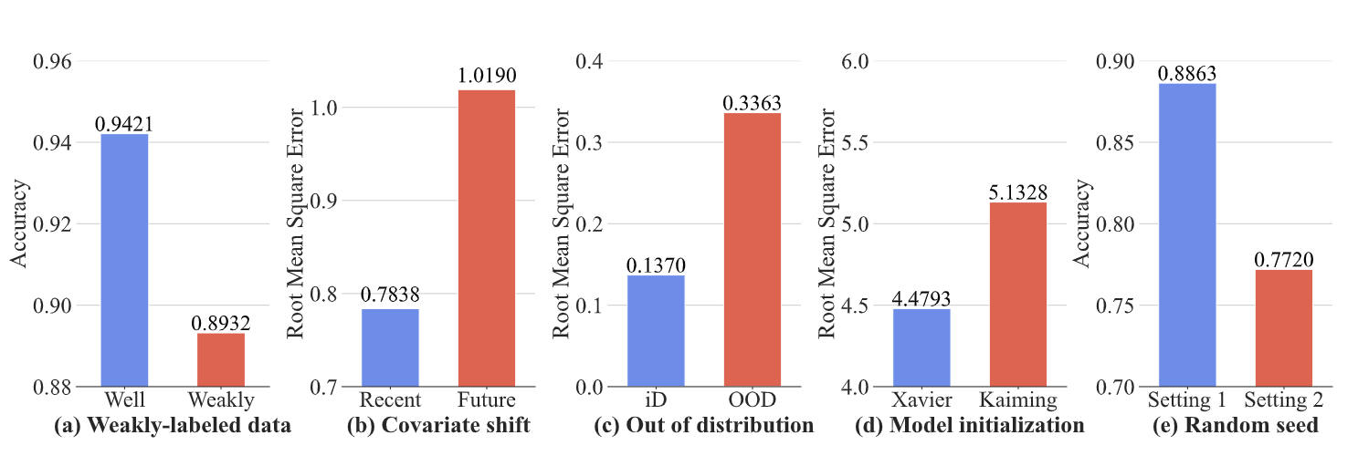
Work 1: Data and Configuration Variances in Robust Deep Learning cont.
Impacts of Single Factors
Notes:
We consider the following five single factors impacts.
The first one is Weakly-labeled data,
which contains incomplete or partially labeled training samples, can adversely affect the accuracy of the trained deep neural network models.
The experiment was running on the TrashNet dataset which contains plastic and glass bottle images with a small proportion of incorrectly labeled data.
The RecycleNet utilized in this project has shown a decrease in classification accuracy due to these weakly-labeled samples in the training set.
The second one is Covariate shift,
which demonstrates a distribution shift among different segments of time periods, causes the performance decrease of the trained model.
The third one is Out of distribution data,
which are introduced by the open set, causes the untrustworthy estimation of the DNN model performance.
The fourth one is Model initialization.
Model initialization causes DNN instabilities varied in different initialization methods.
We perform the experiments with the same dataset and implementation, except for the weight initialization in the wind speed forecasting project.
The last one is random seed.
Random seed introduces non-deterministic factors during the training of DNNs when stochastic algorithms are utilized.

Slide 14
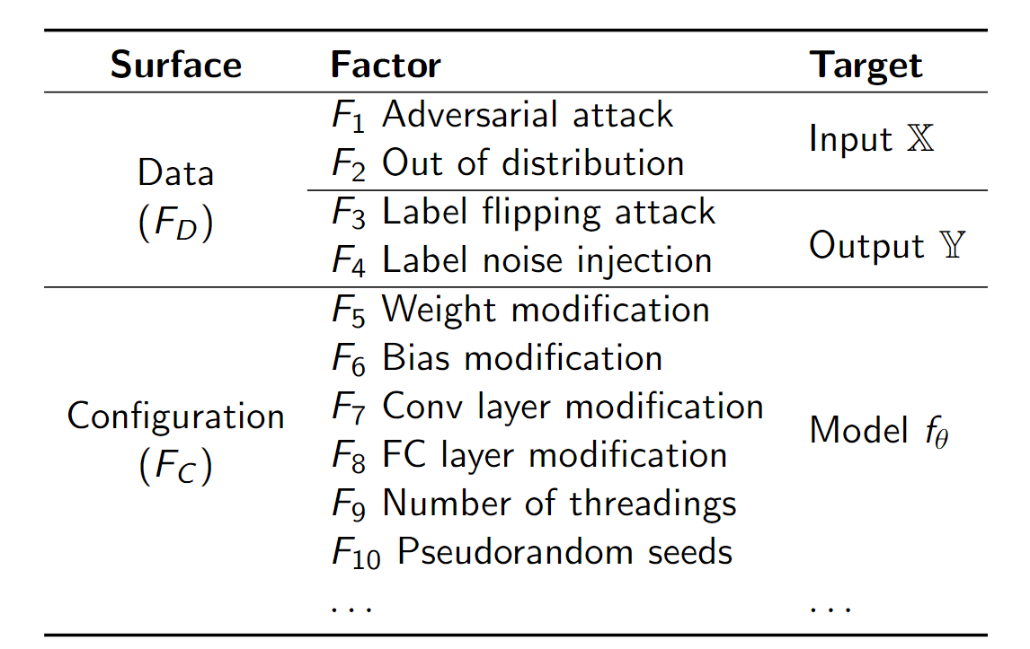
Work 1: Data and Configuration Variances in Robust Deep Learning cont.
Robustness affecting factors
Notes:
In the following part of the paper,
we categorize the robustness affecting factors from different surfaces including data and configurations based on the impacted targets which includes input output and model.

Slide 15
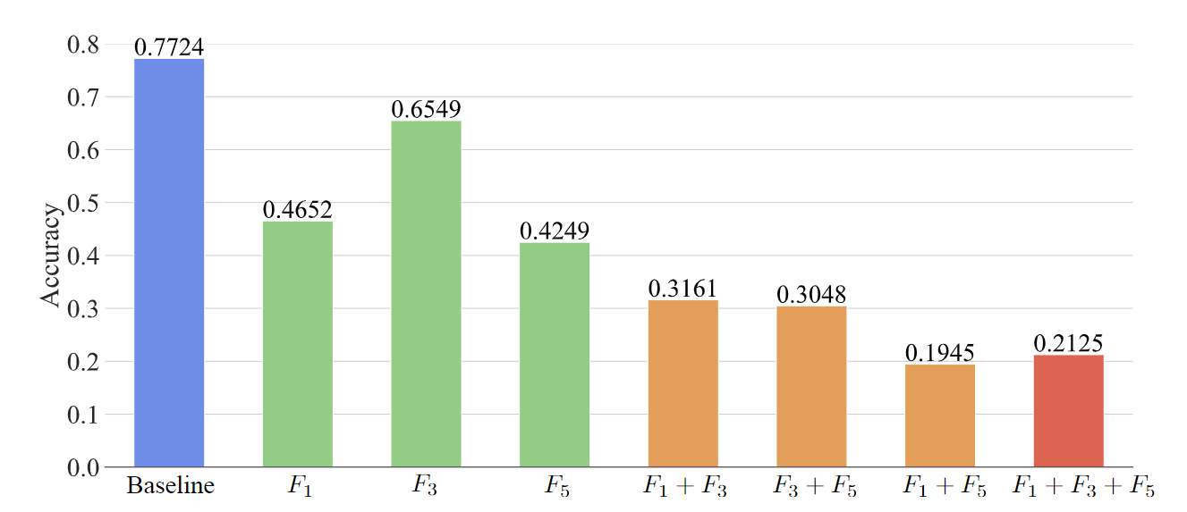
Work 1: Data and Configuration Variances in Robust Deep Learning cont.
Impacts of combinatorial factors on an image classification DNN model
Notes:
It shows the accuracy of combination factors for deep neural networks.

Slide 16
Work 1: Data and Configuration Variances in Robust Deep Learning cont.
Sequential model-based optimization
Evaluate
Select
Search-based Variance Prediction
Reinforcement learning
State
Action
Transition
Reward
Scaling rate
Evolutionary algorithm
Select
Mutate
Crossover
Evaluate
Notes:
In the end, we perform search-based variance prediction including Evolutionary algorithm , Reinforcement learning, Sequential model-based optimization.

Slide 17
Work 2: Understanding the Robustness of Machine Unlearning Models
Submitted to ISSTA 2023
Notes:
The second work is Understanding the Robustness of Machine Unlearning Models which was submitted to ISSTA.

Slide 18
Work 3: A Fake News Detection Survey from Modality Perspective
Ready to be submitted
Modality
Text
Audio
Video
Image
Notes:
The third work is a fake news detection survey from modality perspective.
It just finished and is ready to submitted.
In this survey, it contains the neural networks for different modality methodologies and their corresponding datasets.
These neural networks and datasets are the source of neural network verification.
This work can be seen as the preparation of data for the future research, besides prestigious datasets such as MNIST or CIFAR series.

Slide 19
Thank you
Questions?
Notes:
That’s the end of the presentation. Thanks for listening.

